Slide 1


CAR DEALER MANAGEMENT SYSTEM

Slide 2
PREPARED BY :-
Student 1 Name :- Anshul Mundra (25002171810001)
Batch :- C1
Branch :- CSE-DS
Student 2 Name :- Bhanu Ganesh Ajitkumar (25002171710005)
Batch :- C1
Branch :- CSE-AI
Student 3 Name :- Soni Heer Saurabhkumar (25002171710029)
Batch :- C1
Branch :- CSE-AI

Slide 3
PROJECT OUTLINE
  Purpose of the project
  System design diagram (Flow-chart)
  ER Diagram
  Functionalities
  Used DATA Structures and class
  Triggers and procedures
  Tools used
  Merits & Demerits
  Future Scope

Slide 4
PURPOSE OF THE PROJECT
The Car Dealer Management System is a console-based application developed to automate the daily operations of a car dealership.
It helps to manage :-
Goal :-
  Car inventory
  Customer records
  Sales
  Payments
  Reports
  Admin Login
  Reduce manual paperwork
  Store data securely in MySQL
  Generate reports quickly
  Improve dealership management efficiency

Slide 5
ueueie
DIAGRAM
FLOWCHART
2. ER DIAGRAM

Slide 6
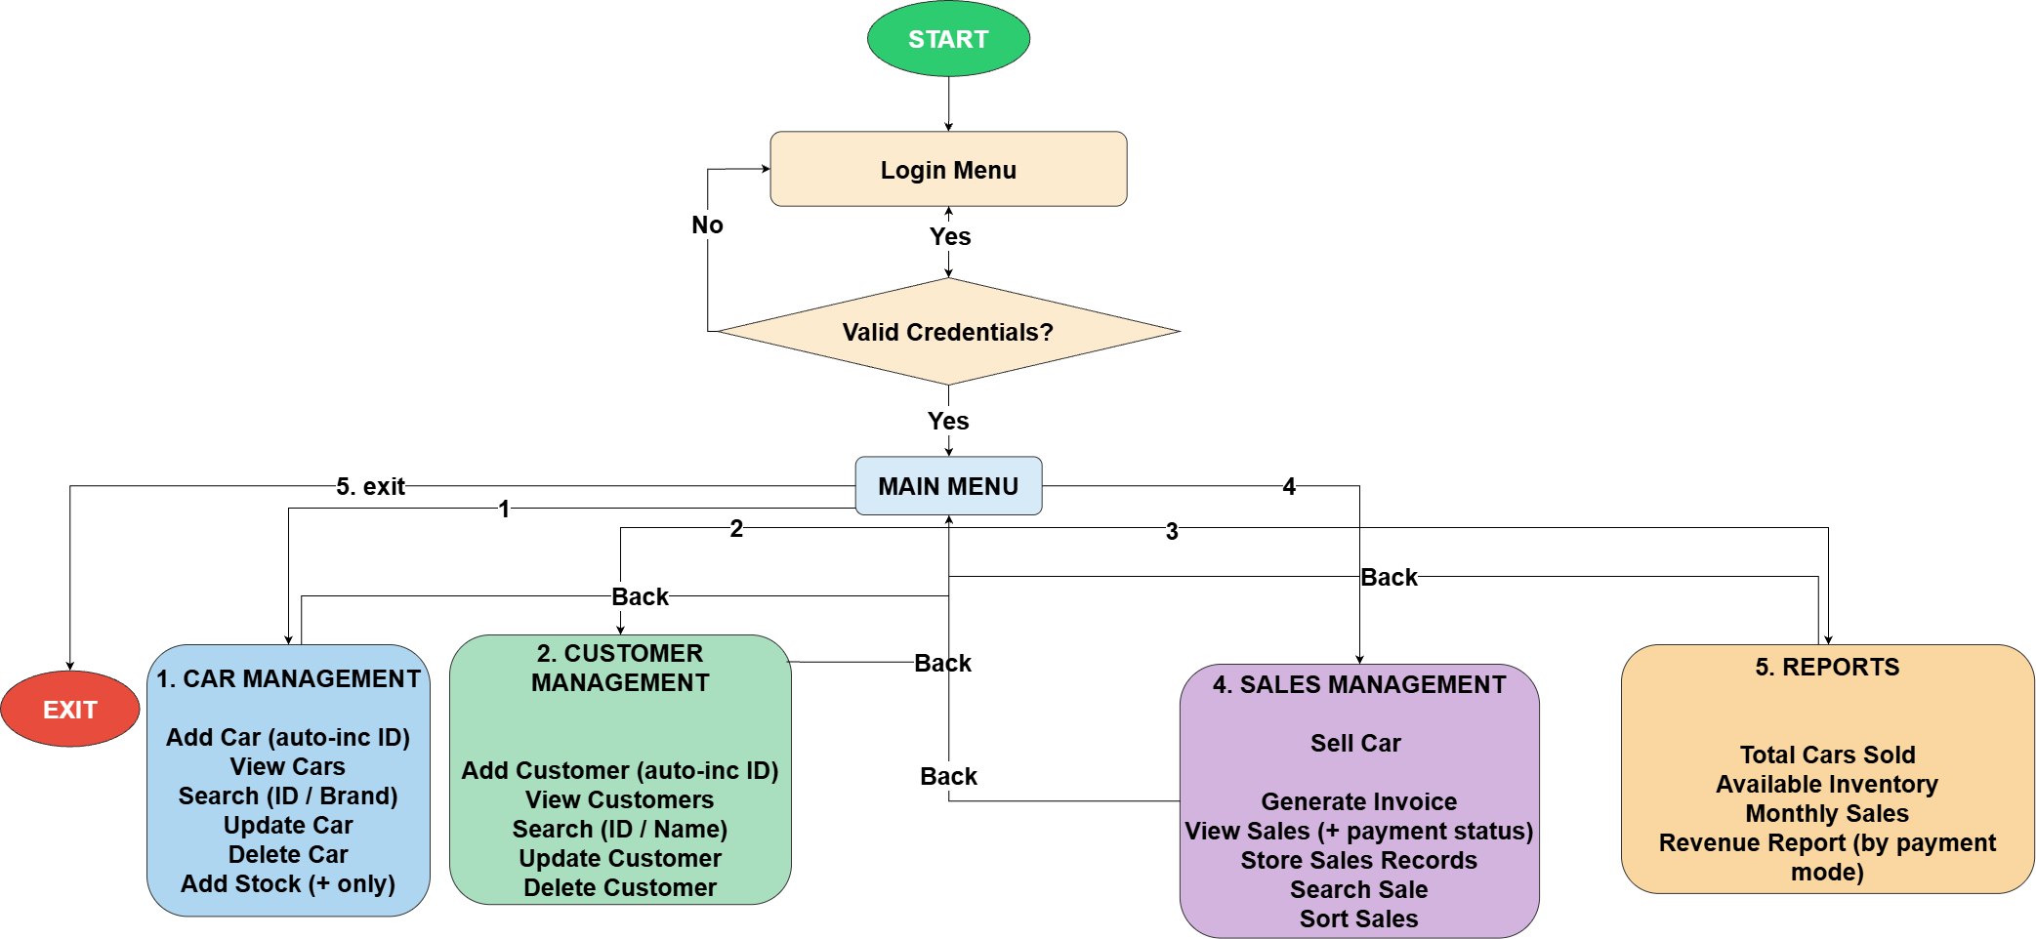

Slide 7
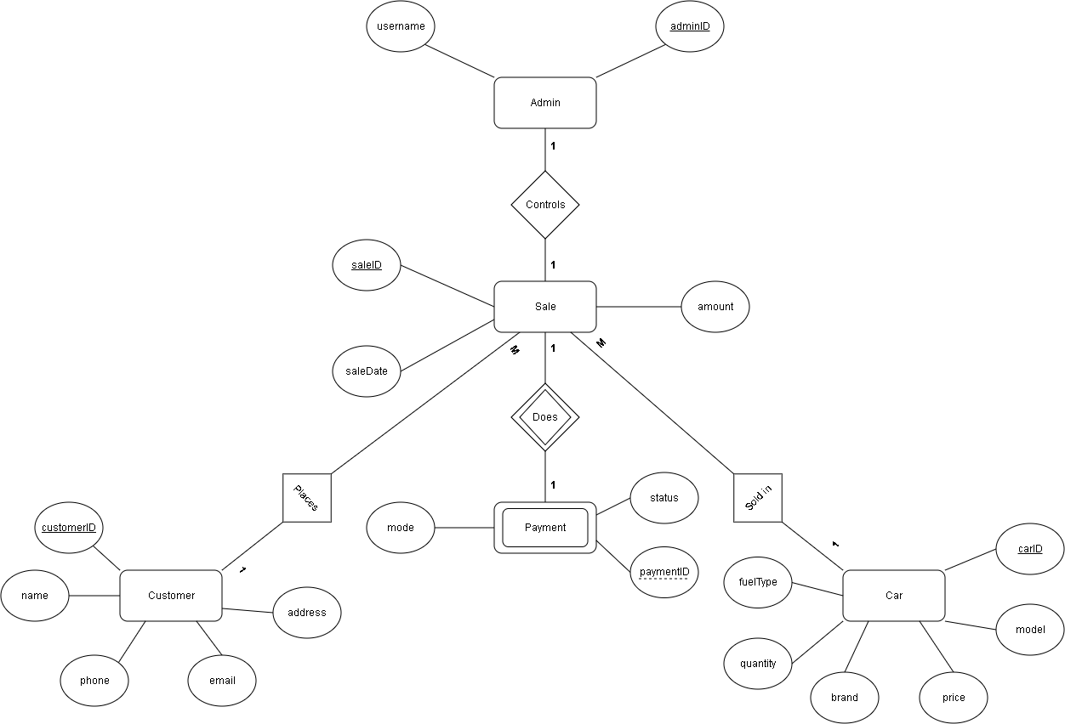

Slide 8
FUNCTIONALITIES OF PROJECT RELATED WITH PARTICULAR SUBJECT
Data Structure using JAVA | JAVA-II | Database Management
LinkedList(CustomerLinkedList) in customer class. | Exception Handling in every class using Try..catch() block. | Triggers used for insert and update in Car Class
2. Stack(MyStack) in Login Class. | 2. ArrayList for data storage in every class. | 2. Procedure used for insert in Sales Class
3. HashMap in Sales Class. | 3. JDBC connectivity to save data permanently. | 3. Using CRUD operation using Query in every Class.
4. Collection classes for Storage of Data | 4. Using OOPs concepts such as polymorphism,encapsulation and access modifiers. | 4. Foreign key constraint.

Slide 9
USED DATA STRUCTURES AND CLASS
Data structures :-
Important classes :-
  LinkedList
  BST
  Stack
  HashMap
  Main
  MainMenu
  LoginMenu
  CarMenu
  Customer
  CustomerMenu
  SalesMenu
  PaymentMenu
  Displayable
  ReportMenu
  DBConnection
  CustomerLinkedList
  MyStack

Slide 10
TRIGGERS AND PROCEDURES
Stored Procedures :-
Triggers :-
  InsertSale()
  CheckPriceInsert
  CheckPriceUpdate
  CheckQuantity

Slide 11
TOOLS USED
  JDK
  JDBC
  MySQL
  XAMPP
  IntelliJ IDEA

Slide 12
MERITS AND DEMERITS
Merits :-
Demerits :-
  Easy to use
  Fast record management
  Secure admin login
  Reduces paperwork
  Uses MySQL database
  Generates reports
  Console-based interface
  Single admin login
  No online booking
  Local database only
  Limited security features

Slide 13
FUTURE SCOPE
  GUI using JavaFX or Swing
  Web-based application
  Mobile App
  Online payment gateway
  Customer Login
  Cloud Database
  AI-based Sales Analysis
  Vehicle Insurance Integration

Slide 14
THANK YOU

